Slide 1



LOOK BACK 3
Part 2

Slide 2
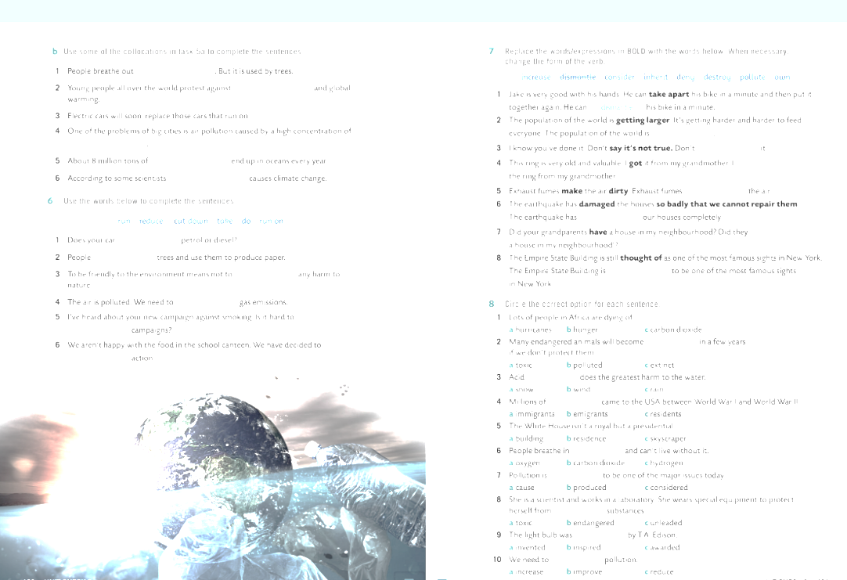
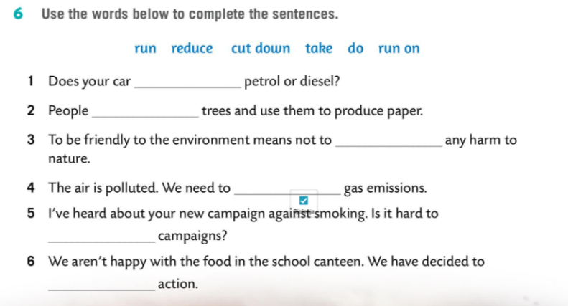
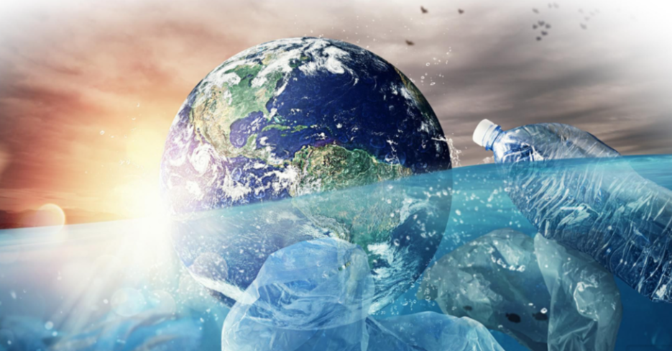
run on
cut down
do
reduce
run
take

Slide 3

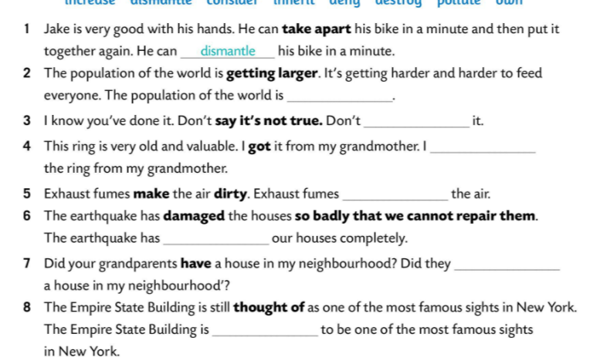
increasing
deny
inherited
pollute
destroyed
own
considered

Slide 4

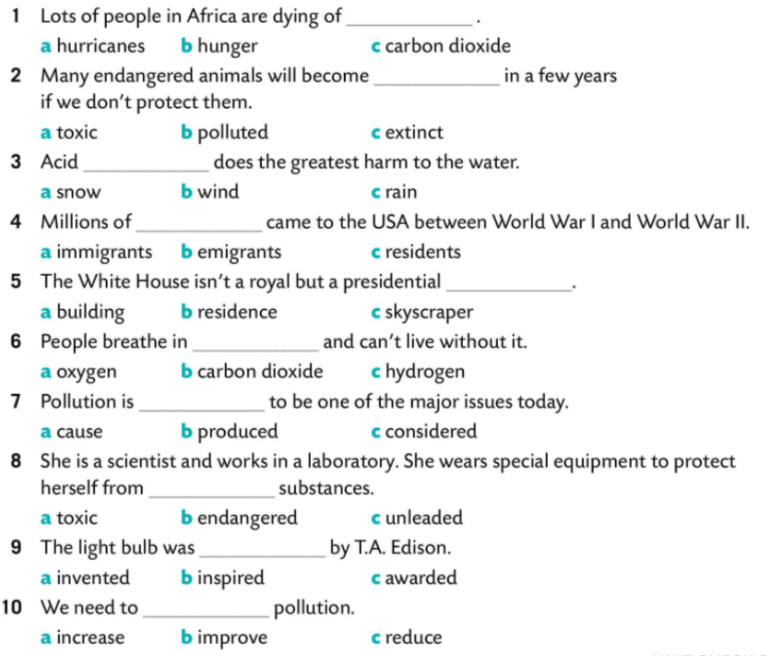



Slide 5
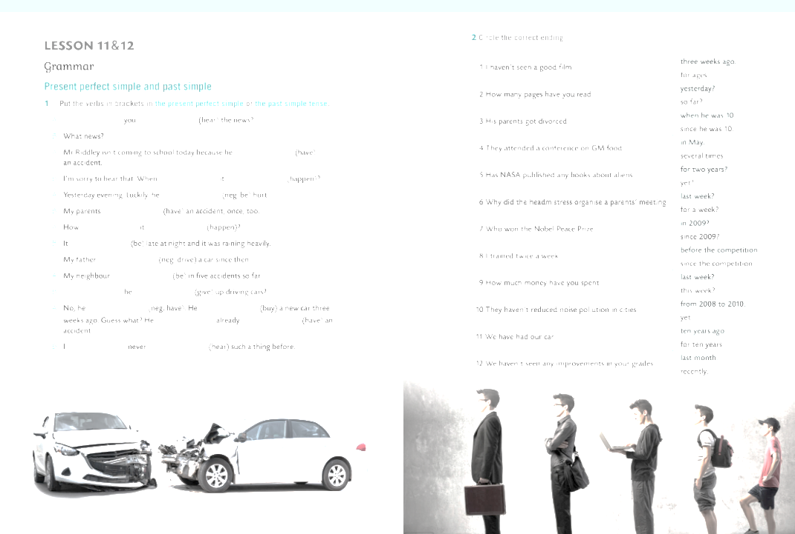

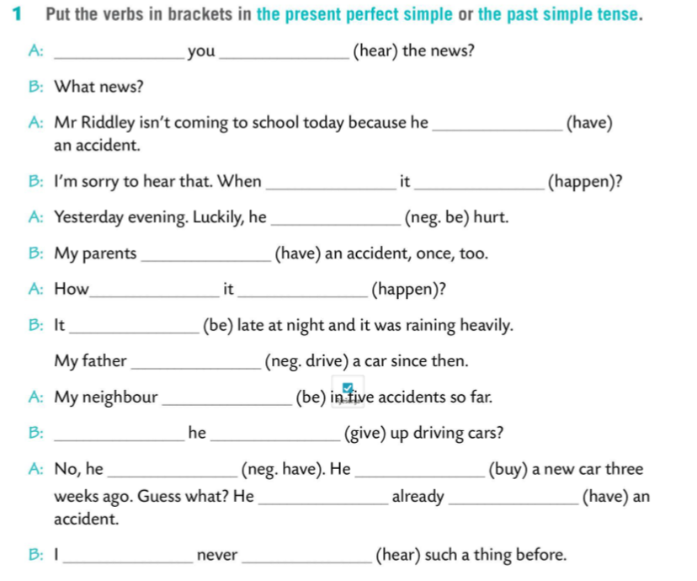
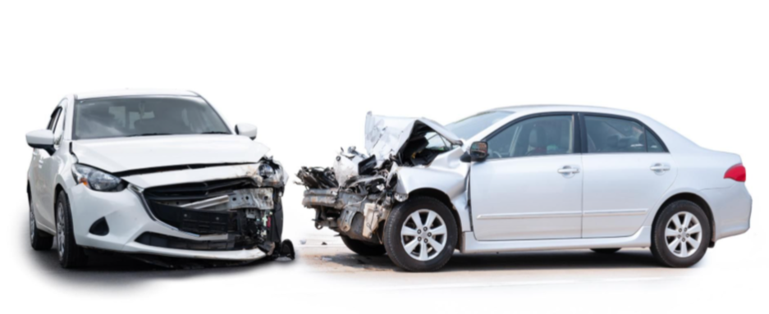

Have
heard
has had
did
happen
wasn’t hurt
had
did
happen
was
hasn’t driven
has been
Has
given
hasn’t
bought
has
had
have
heard

Slide 6
